Slide 1
PREJUDICE, DISCRIMINATION & STEREOTYPING
What do you understand by these terms?
Do they overlap?

Slide 2
Stereotype
A belief about the personal attributes of a group of people. Stereotypes are sometimes overgeneralized, inaccurate, and resistant to new information (and sometimes accurate). They may be positive or negative but they impact how social information is processed.

Slide 3
Prejudice
A preconceived negative judgment of a group and its individual members, an irrational attitude based on group membership.

Slide 4
How would you define gender stereotypes?
Can it be both positive and negative?
When does this become a prejudice?

Slide 5
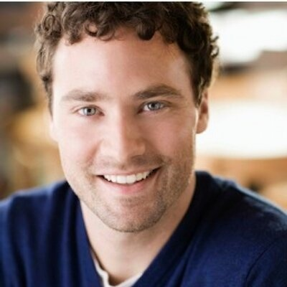
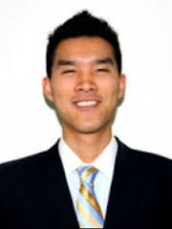
A
Q. Person A meets person B for the first time. Person A says the following, ‘hey, I must say your accent is perfect. You must have practiced a lot. When did you move here from China?’ person B says ‘eh, excuse me. I was born here. I am as American as you are.’
What happened here. Give your reason?
B

Slide 6
Discrimination
Unjustified negative behavior toward a group or its members

Slide 7
Quick Q/A
Jones thinks that physically handicapped people are also intellectually disabled-
Stereotype
Jones meets a girl and thinks to himself “This girl has polio and there are high chances she might also have mild intellectual deficit”-
Prejudice
Jones meets the mother and asks her “I notice she has polio, does your daughter have mild intellectual deficit also”-
Prejudice
The girl is seated next to Jones, he starts to feel uncomfortable and leaves his seat to sit else where-
Discrimination

Slide 8
Examples from the book-
1. RELIGION
Muslims not hired / paid well by managers (Park et al, 2009). What is this?
Example of discrimination based on religion
Muslims perceive Westerners as greedy and immoral (Wike & Grim, 2007). What is this?
Stereotype, generalizing Westerners as greedy

Slide 9
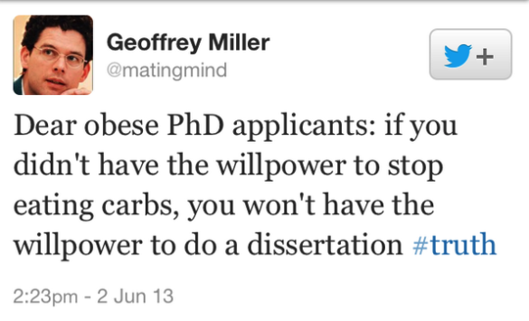
2. WEIGHT
Overweight people marry less often, gain entry to less-desirable jobs, and make less money (Swami & others, 2008).
Weight discrimination, exceeds racial or gender discrimination and occurs at every employment stage—hiring, placement, promotion, compensation, discipline, and discharge (Roehling,2000)
More often bullied, and as adults, they are more often depressed

Slide 10
DEFINITION OF STEREOTYPE:
They are beliefs, not prejudice. Stereotypes may support prejudice, yet one might believe, without prejudice that men and women are different yet equal
Stereotype should be seen as the picture that comes to mind when one thinks about a certain group
Certain examples given in the book include
Professors are absent minded
Americans are outgoing
Pakistanis are…?

Slide 11
‘Politician are all crooks, but our senator Jones is a good guy’. This is?
A stereotype without prejudice towards an individual
A group of black kids walk into a shop. The owner was watching a show on his laptop, but paused the episode to keep a closer eye on the kids in his store.
Discrimination
Asim, being an exchange student from Pakistan, was thought to be good at mathematics because he was from an Asian country.
Prejudice

